Slide 1
Patrick Bauer
Deep Personalization Research
2026-03-08 | Director of Business Strategy, Advisory Practice @ Acquisition.com

Slide 2
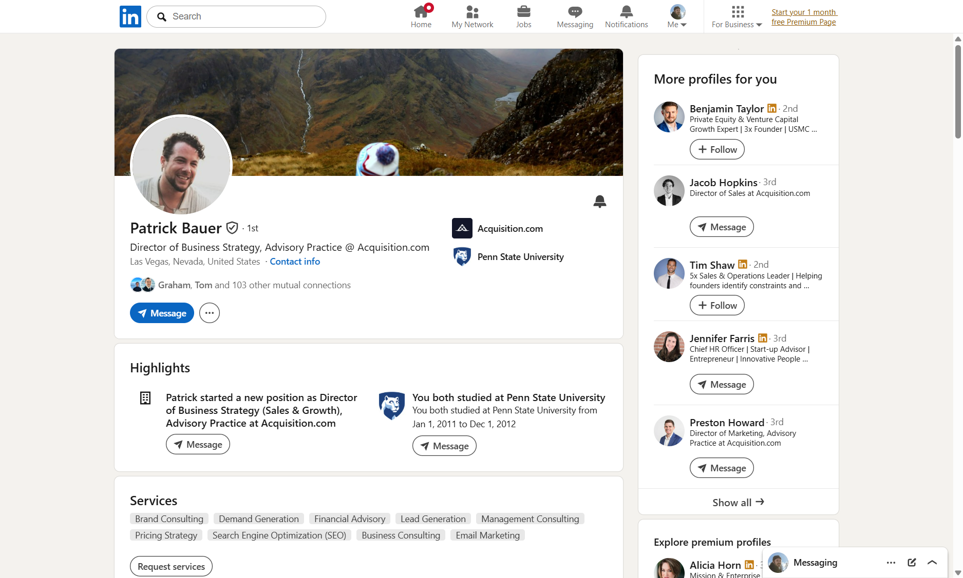
Profile Overview
Name: Patrick Bauer
Headline: Director of Business Strategy, Advisory Practice @ Acquisition.com
Location: Las Vegas, Nevada, United States (previously Santa Monica, CA)
Current Role: Director of Business Strategy (Sales & Growth) at Acquisition.com
Connection: 1st (105 mutual connections including Graham, Tom)
LinkedIn: https://www.linkedin.com/in/patrick-bauer-86a29527/
Languages: Czech, Spanish
Education: Penn State University - BS Energy Business and Finance (Oil & Gas), 2008-2012

Slide 3
Career & Companies
Director of Business Strategy (Sales & Growth), Advisory Practice | Acquisition.com** - Full-time | Jan 2026 - Present (3 mos)
Las Vegas, Nevada, United States - On-site
Investor | Winrate** (AI-powered meeting scheduling app, pre-seed, Boston) | Dec 2024 - Present (1 yr 4 mos)
Co-Founder | Head of Commercial Development & Advisory | Amherst Brands / Amherst Advisory** - Full-time | Nov 2019 - Dec 2025 (6 yrs 2 mos)
Santa Monica, California & Dallas, Texas
Co-Founder & Head of Expansion | Avenoo** - Full-time | Mar 2021 - Nov 2025 (4 yrs 9 mos)
Santa Monica, California - Hybrid
Director Of Business Development & Strategic Partnerships | Cura Cannabis Solutions** - Full-time | Jun 2019 - Nov 2019 (6 mos)
Led new market expansion pre-acquisition. Cura Partners (parent of Select Oil brand) was acquired by Curaleaf Holdings for ~$1 billion. Patr...
Earlier Career | - ELLO Capital - role details unknown
- SoCalGas (Southern California Gas Company) - aligns with Penn State Energy Business degree

Slide 4
Systems, Skills & Methodologies
Proprietary Systems
Core Skills
Sales Engines — Repeatable sales engines for 60+ CPG brands (Amherst)
GTM Systems — National expansion playbooks across 39 states (Amherst)
CRM Architecture — Pipeliner CRM implementation (confirmed via video testimonial) (Amherst)
Forecasting Dashboards — Pipeline and revenue forecasting (Amherst)
KPI Frameworks — Sales team measurement frameworks (Amherst)
Retail Access Code — Unique codes retailers share with wanted vendors (Avenoo)
Brand Management
Establishing Strategic Partnerships
Go-to-Market Strategy
Strategic Consulting
Product Strategy
B2B Software
Business Development
Brand Consulting

Slide 5
Personal & Digital Footprint
Instagram: None (confirmed)
Social media presence: Very low — no personal Twitter/X, TikTok, or public Facebook found
Podcast appearances: None found
Books: None
Awards: None found
Sports: None found
Charity/community: None found
IMDB: None (different Patrick Bauer — horror film director)
Family/spouse: Not publicly available
Media Appearances:
Pipeliner CRM Testimonial (Facebook video): Patrick as "President, Amherst Brands" discussing CRM-driven sales optimization. Quote: "I highly suggest using Pipeliner, it is a tool that has absolutely sky-rocketed our business to where it needs to be."
https://www.facebook.com/pipelinercrm/videos/617852646757521/
https://www.pipelinersales.com/sales/case-studies-testimonials/amherst-brands/

Slide 6
Key Takeaways
$1B exit proximity — was at Cura Cannabis during pre-acquisition positioning before $1B Curaleaf deal. Understands M&A preparation and what makes a company acquisition-ready
Hormozi's inner circle — now at Acquisition.com advising $3M-$150M businesses. Has access to the Hormozi playbook (offers, leads, scaling frameworks)
Regulatory navigation expert — built a national business in hemp/THC/delta-8/CBD across 39 states, one of the most complex regulatory landscapes in CPG
Platform builder — Avenoo proves he can conceive, build, and ship a SaaS product. The Retail Access Code is a genuinely novel mechanism
Penn State connection — 2011-2012 overlap, 105 mutual connections. Strong warm intro context
CRM philosopher — public testimonial for Pipeliner CRM; likely has strong opinions on sales ops tooling
AI/automation goldmine — his expertise in CRM architecture, forecasting dashboards, KPI frameworks, and sales engines are all prime targets for AI agent augmentation
Vertically integrated thinker — advisory + distribution + SaaS platform all serving the same market. Understands the full stack

Slide 7
Conversation Starters & Personal Insights
Pipeliner CRM -- he gave a public testimonial; ask about his CRM philosophy and how he'd architect CRM for a new portfolio company
Cura Cannabis / Select Oil -- he was there pre-acquisition ($1B deal); great M&A positioning story
Penn State Energy Business & Finance -- unique degree; how did energy sector lead to cannabis/CPG?
Prague / Charles University -- study abroad in economics; speaks Czech and Spanish
Avenoo's 17K transactions -- what patterns did he see in B2B commerce? What would he do differently?
Transition to Acquisition.com -- why leave his own companies to join Hormozi's team? What's the vision?
Alternative wellness regulatory landscape -- deep expertise navigating hemp/THC/delta-8 compliance across 39 states

Slide 8
Next Steps
Action Items
Creative Personalization Angles
Session: TBD
Prepare 3 tailored questions from Key Takeaways
Reference shared connections in opening
Explore AI/automation angles for his domain expertise
Languages (Czech, Spanish) — cultural bridge, study abroad in Prague
Penn State — shared connection, 105 mutual contacts
$1B exit proximity — was at Cura during Curaleaf acquisition
Hormozi inner circle — has the scaling playbook, ask about it
Systems builder — multiple proprietary methodologies = loves process
Low digital footprint — approach as a builder, not an influencer

